Slide 1
Parallelized Convolutional Layer
方君安 林彥傑 彭敬樺
0416076 0416213 0416106
Team 12

Slide 2
Introduction
Related Works
Parallelized Convolutional Layer
Method
Testing Environment
Experiments
Conclusion

Slide 3
Introduction
1

Slide 4
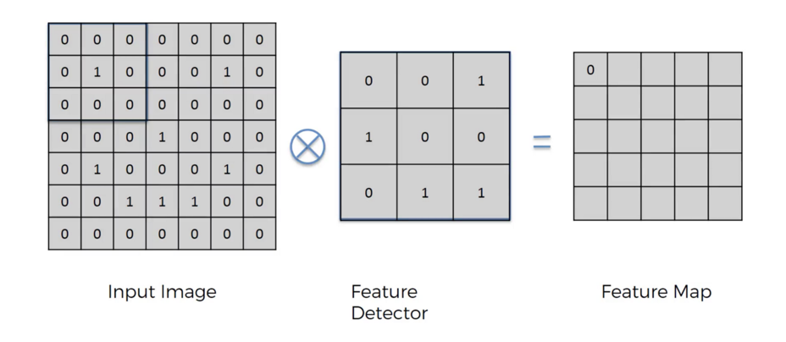
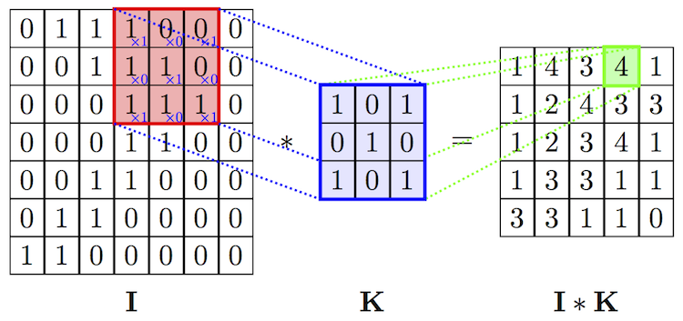
Convolutional Layer
Figure1. Computing Convolutional Layer

Slide 5
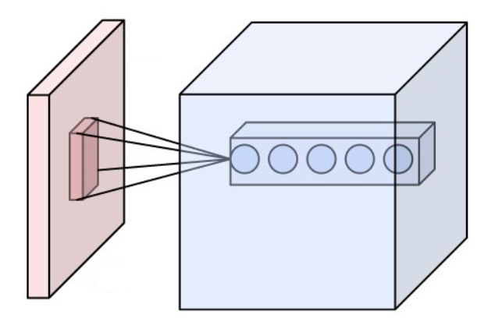
The layer's parameters consist of a set of learnable filters (or kernels), which have a small receptive field
During the forward pass, we compute the dot product between the entries of the filter and the input
Convolutional Layer
As a result, the network learns filters that activate when it detects some specific type of feature at some spatial position in the input
Figure2. Convolutional Layer

Slide 6
Related Works
2

Slide 7
Parallelizing Convolutional Neural Network Training (http://bcliu.github.io/parallel-cnn/)
Parallel Deep Convolutional Neural Network Training by Exploiting the Overlapping of Computation and Communication – HiPC 2017
Reference
Filter Shaping for Convolutional Neural Networks – ICLR 2017
Deep Residual Learning for Image Recognition - CVPR 2015
What do Deep Networks Like to See - CVPR 2018

Slide 8
Method
3

Slide 9
Our Approach
Parallelized implementation using OpenMP
Optimizing memory access in CUDA implementation
Serial Implementation
Parallelized implementation using CUDA

Slide 10
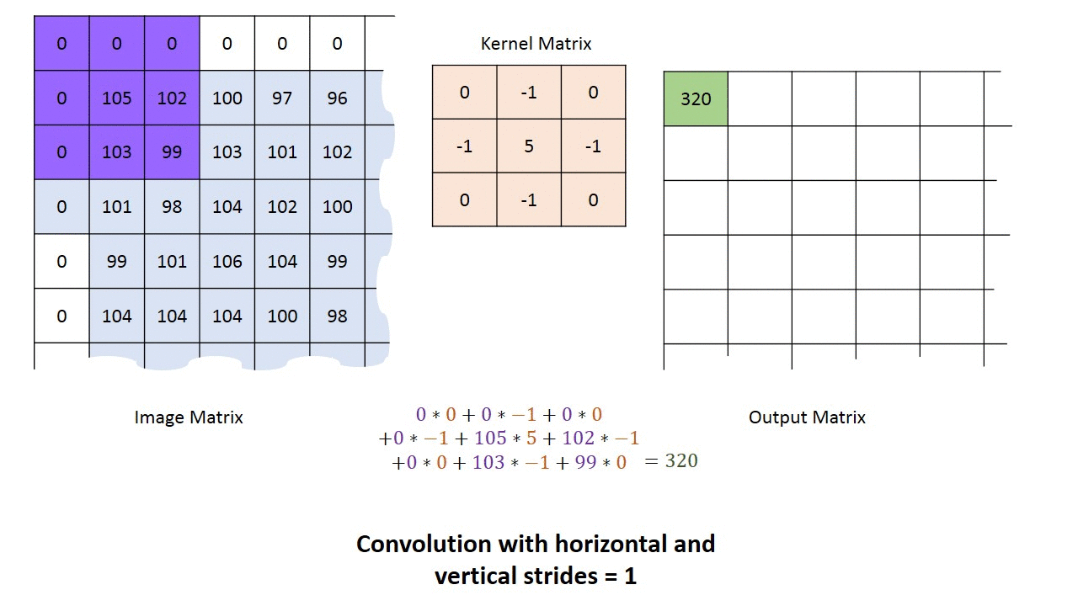
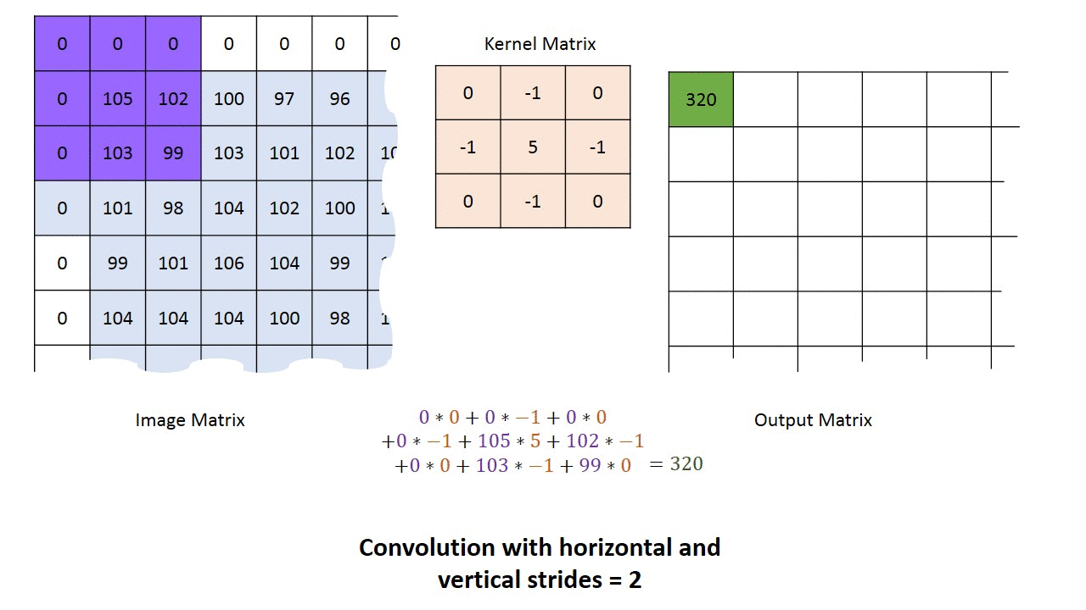
Serial Approach

Slide 11
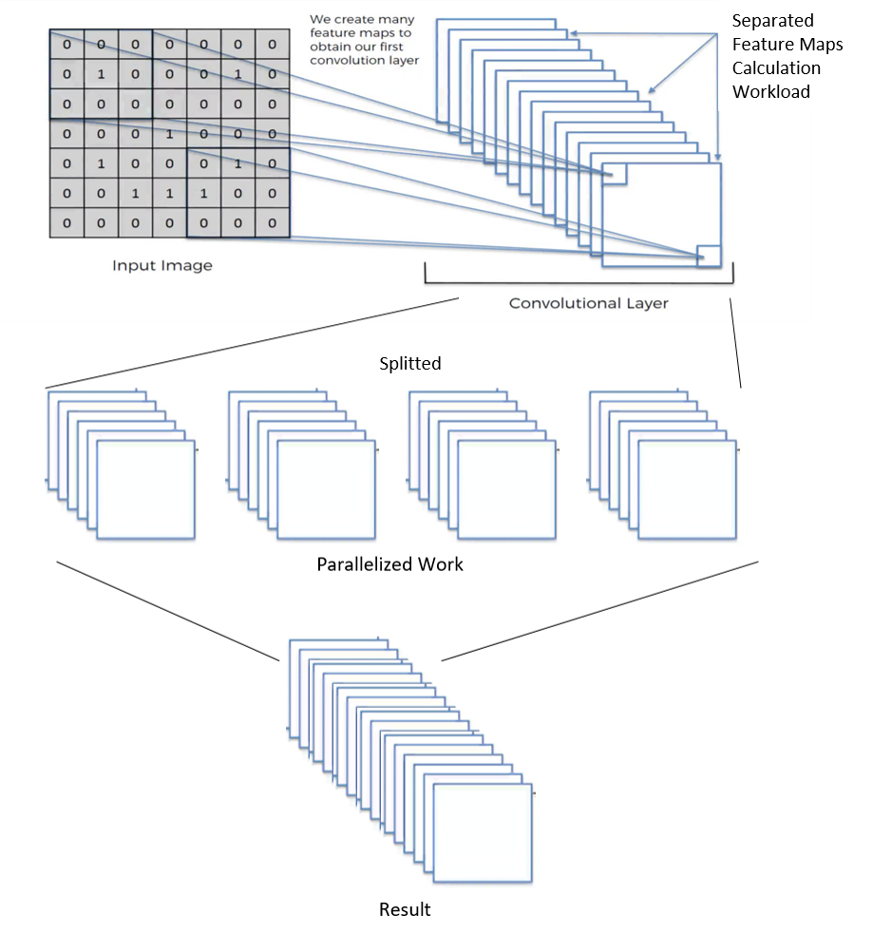

OpenMP Approach

Slide 12
CUDA Approach
One feature map’s element maps to thread
Store Input image in global memory
Store Filter in global memory

Slide 13
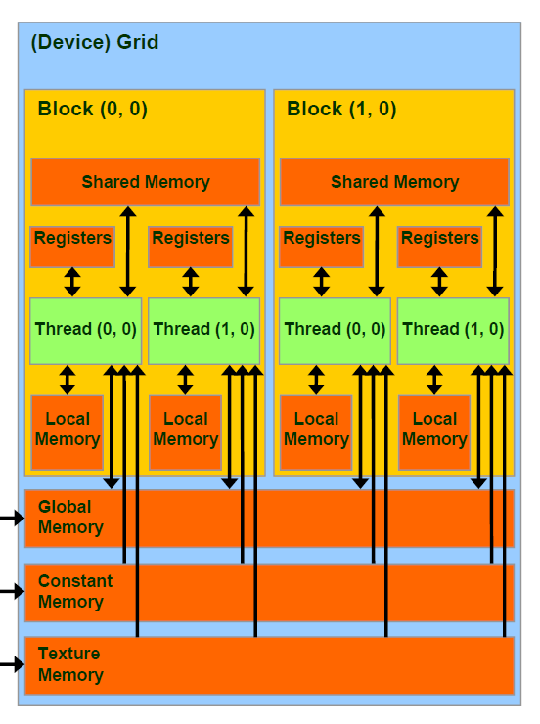
Improvement
Use different memory spaces
R/W per-block shared memory
Read only per-grid constant memory

Slide 14
Put filters in constant memory
Compute to off-chip memory access ratio
close to 1:1
Put image in shared memory

Slide 15
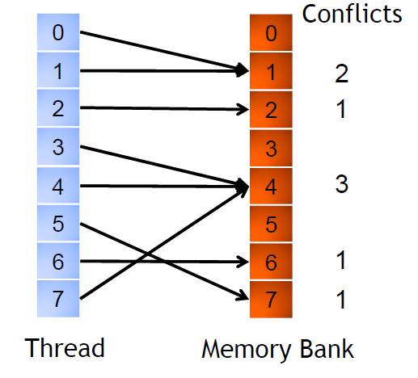
Bank conflicts
If multiple accesses occur to the same bank
Use Cuda nvprof to detect bank conflict
shared_load_transactions_per_request

Slide 16
Testing
Environment
4

Slide 17

OS: Ubuntu
CPU: i7 8700k (6cores 12 thread)
Specs
RAM: 64GB
GPU: NVIDIA RTX 2080 8GB

Slide 18
Experiments
5

Slide 19
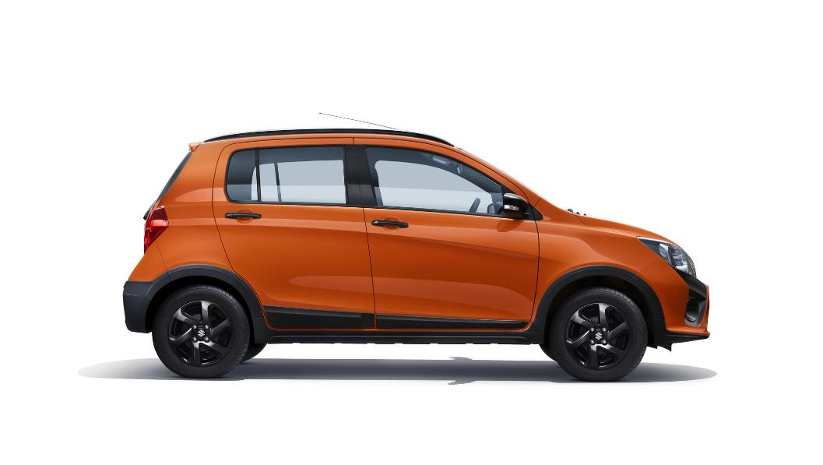
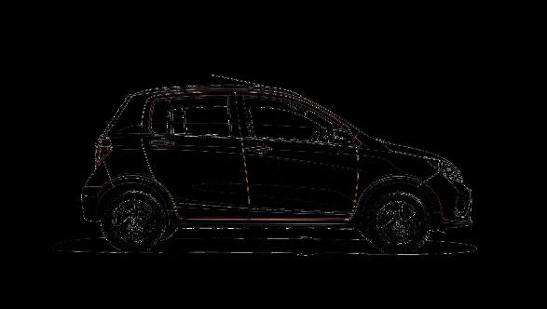
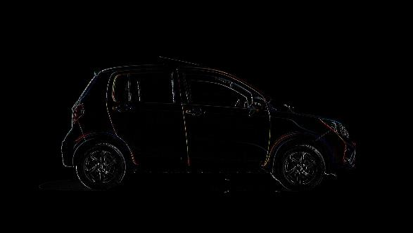
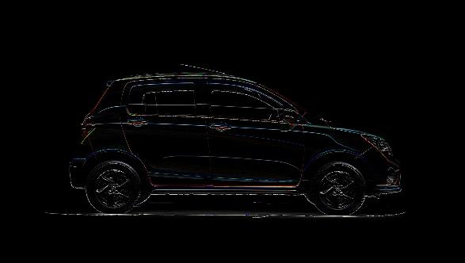
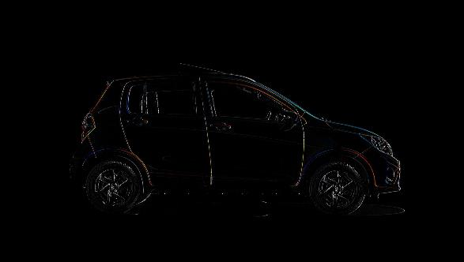

Slide 20
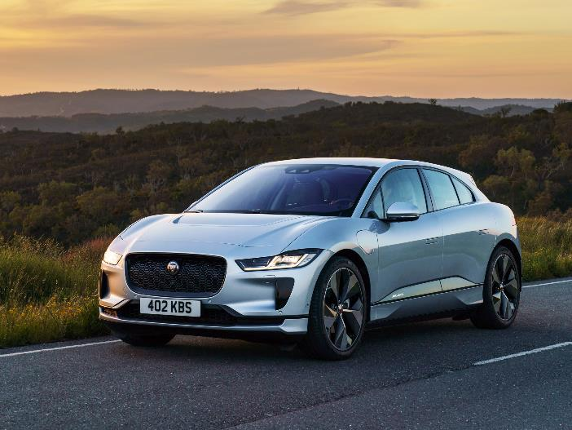
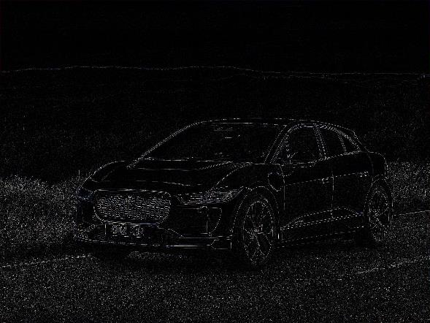
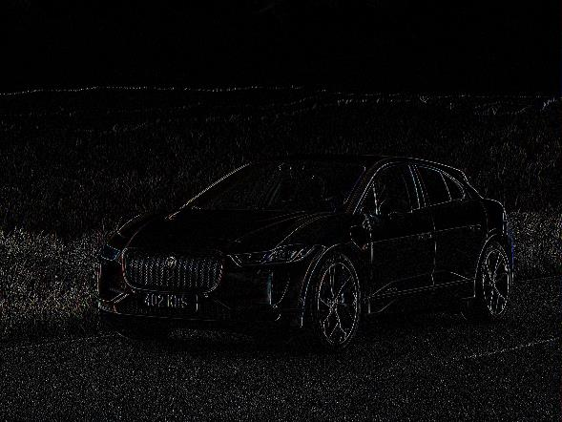
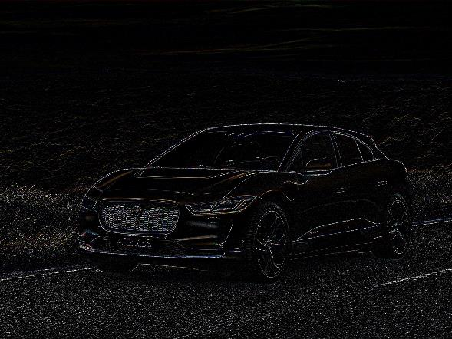
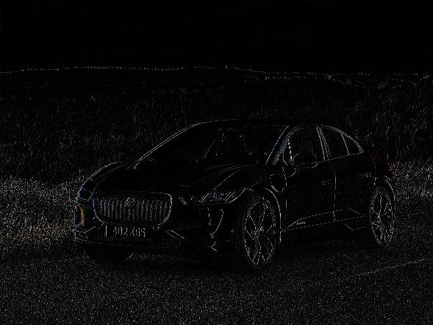

Slide 21
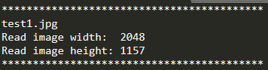
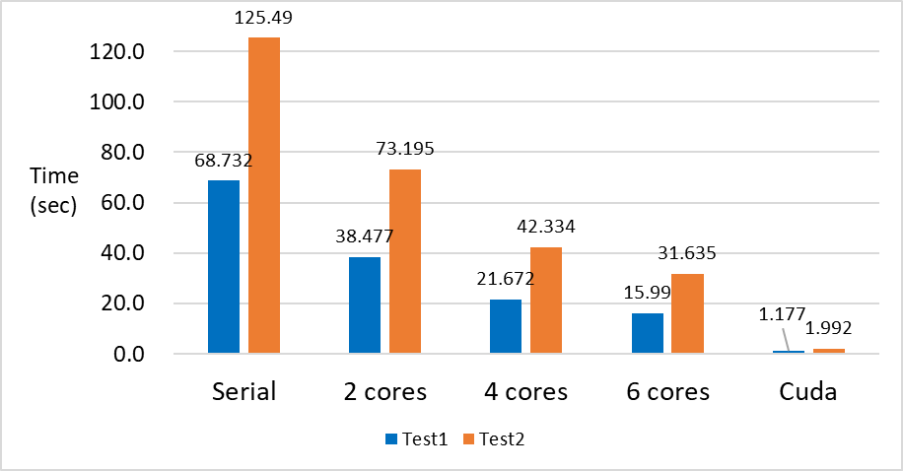
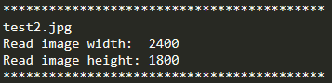
 | Serial | 2 cores | 4 cores | 6 cores | Cuda
Test1 | 68.732 sec | 38.477 sec | 21.672 sec | 15.99 sec | 1.177 sec
Test2 | 125.49 sec | 73.195 sec | 42.334 sec | 31.635 sec | 1.992 sec

Slide 22
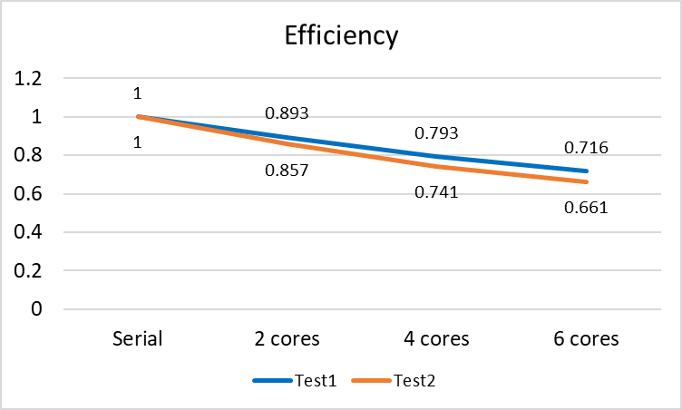

Slide 23
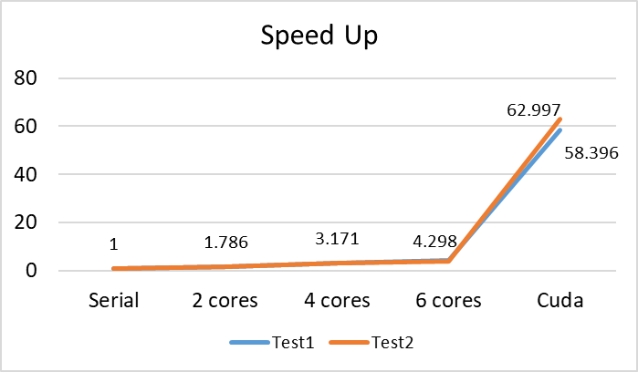
 | Serial | 2 cores | 4 cores | 6 cores | Cuda
Test1 | 1.0 | 1.786 | 3.171 | 4.298 | 58.396
Test2 | 1.0 | 1.714 | 2.964 | 3.967 | 62.997

Slide 24
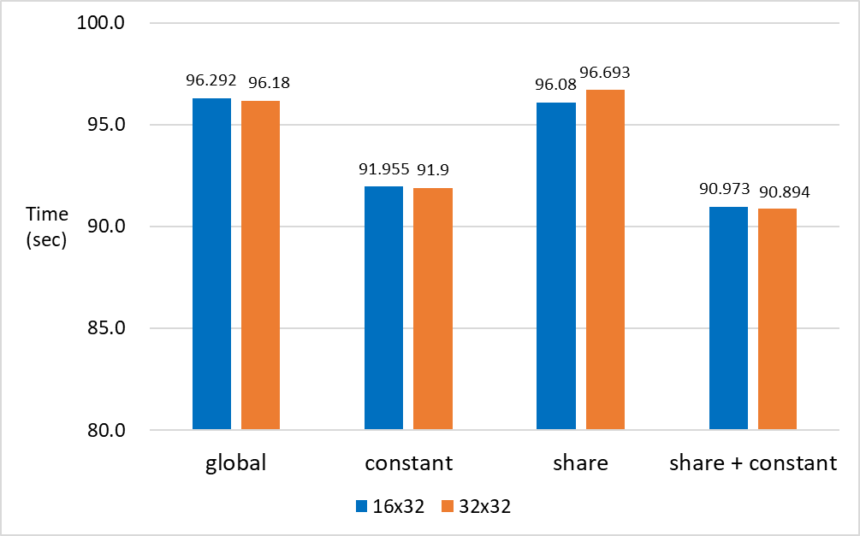
 | global | constant | share | share + constant
16x32 | 90.292 sec | 91.955 sec | 96.08 sec | 90.973 sec
32x32 | 96.18 sec | 91.9 sec | 96.693 sec | 90.894 sec

Slide 25
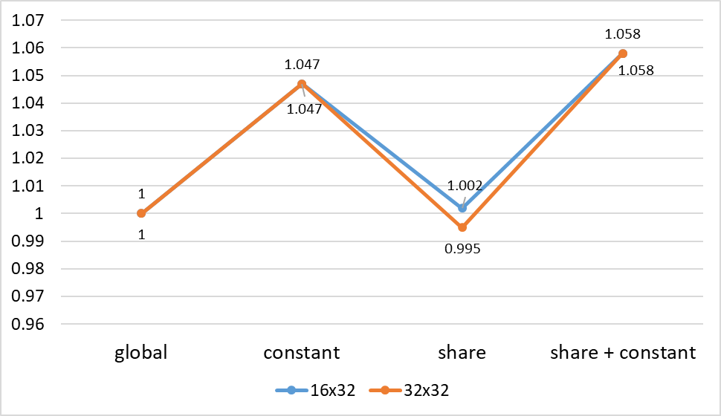

Slide 26
Conclusion
6

Slide 27
Conclusion
OpenMP
CUDA Memory
OpenMP produces good enough result with minimal effort
The importance of managing memory location for data calculated using CUDA
Current Condition
Filter Size
Small filter size could not clearly represent improvement made using shared memory (20% GPU utilization only)
Speedup increase as filter size and image size increase when using CUDA without 100% utilization

Slide 28
Thanks!
Any questions?

